Slide 1
Module 3: Basic Git Commands

Slide 2
Describe Git Hub Repository.
Describe techniques like Branching, Commiting, Pull Requests, and Merging with respect to GITHub Repository.
Apply various Git Bash commands.
Use the commands to synchronize the local and remote repository.

Slide 3
Topic List
GitHub Repository
Git Bash Commands
Synchronizing Local and Remote Repository
Exercise 3.1: Working in GitHub
Exercise 3.2: Using Git Basic Commands

Slide 4
Topic List
GitHub Repository
Git Bash Commands
Synchronizing Local and Remote Repository
Exercise 3.1: Working in GitHub
Exercise 3.2: Using Git Basic Commands

Slide 5

GitHub Repository (1)
What is a GitHub Repository?
A GITHub repository stores all the files for a particular project.
It is accessed over a network, acting as a server and version control tool acting as a client.
Clients can connect to the repository, and then they can store/retrieve their changes to/from the repository.
Client
By retrieving changes, a client takes other people's changes as a working copy.
Server
By storing changes, a client makes these changes available to other people

Slide 6
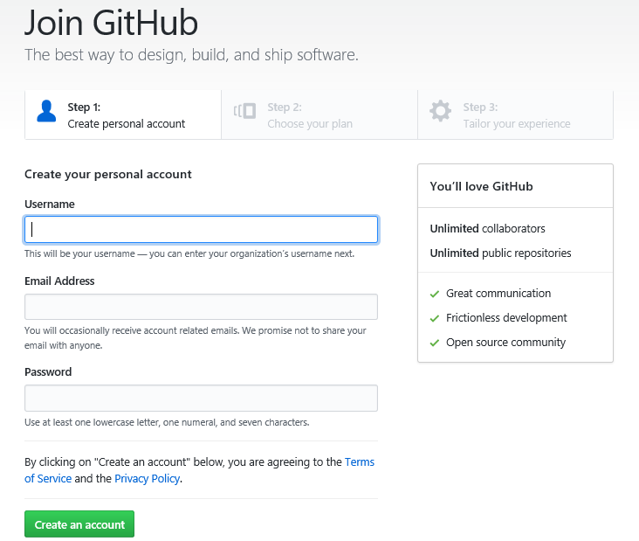
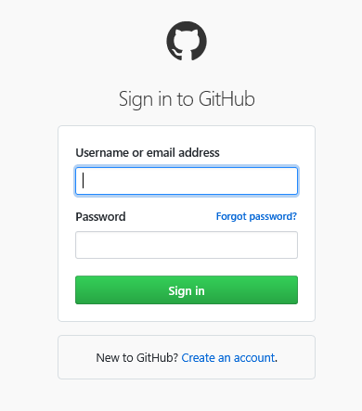
GitHub Repository (2)
Steps to Create a Github Account
Following are the steps to create an account in GitHub:
Login to https://github.com/join in new browser.
Create new account by giving username, email address and password and login.
Provide the necessary required details and create an account.
After creating the account you need to verify it using the given email address. After verification you can login to your GitHub account.
The Login page of Git Hub

Slide 7
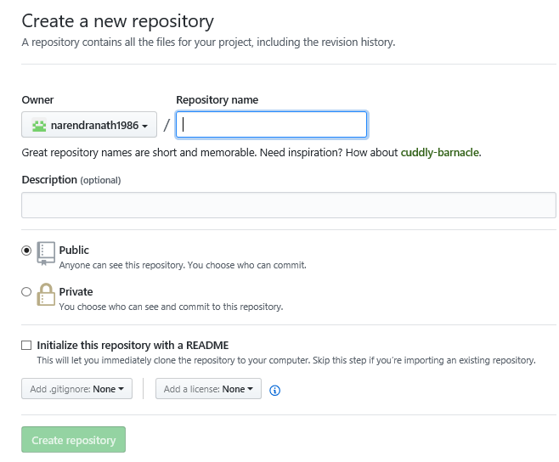
GitHub Repository (3)
Steps to Create a Repository in GitHub
Following screen capture shows the steps to create a repository in Git
Provide name of new Repository. Example: SampleProject
Select the Public or Private check box.
Select the “Initialize this repository with a README” option.
Click Create Repository.
Name the repository and create a repository for your GitHub account.
Note: Each project has its own repository with a unique URL.

Slide 8
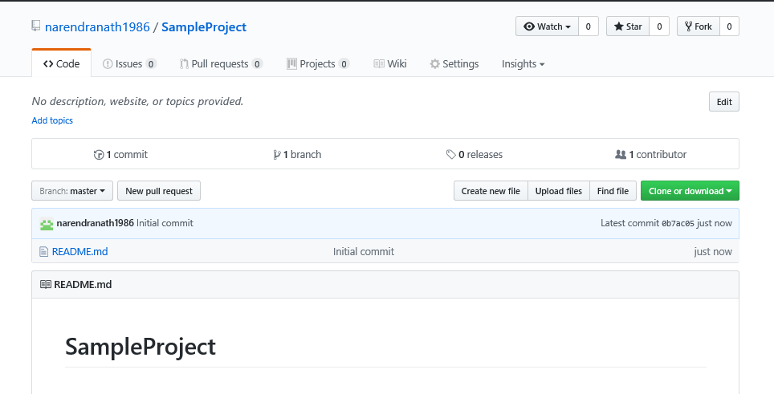
GitHub Repository (4)
GitHub Repository Project
Following screen capture shows of GitHub Repository project:

Slide 9
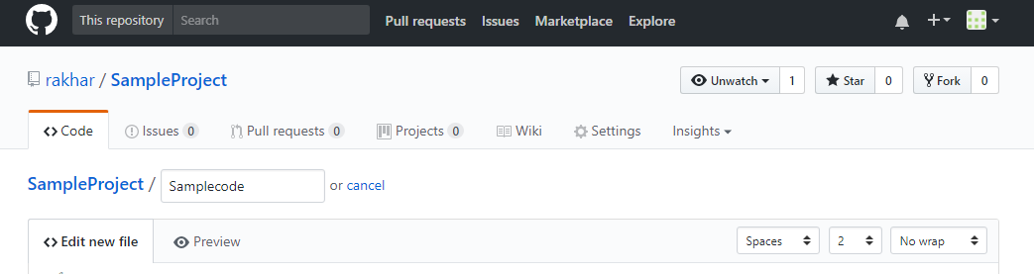
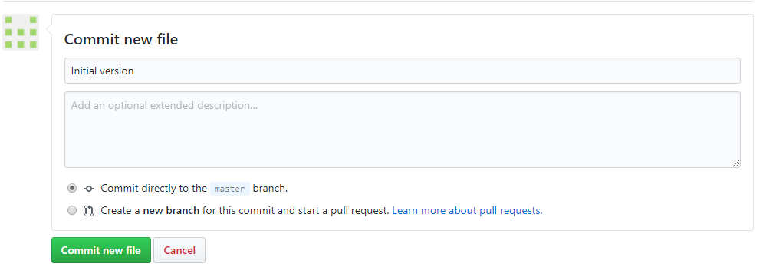
GitHub Repository (5)
Adding Files to the Project
Following screen capture show how add files to the project:
Create new file, add lines of code, give comments and click Commit new File.

Slide 10
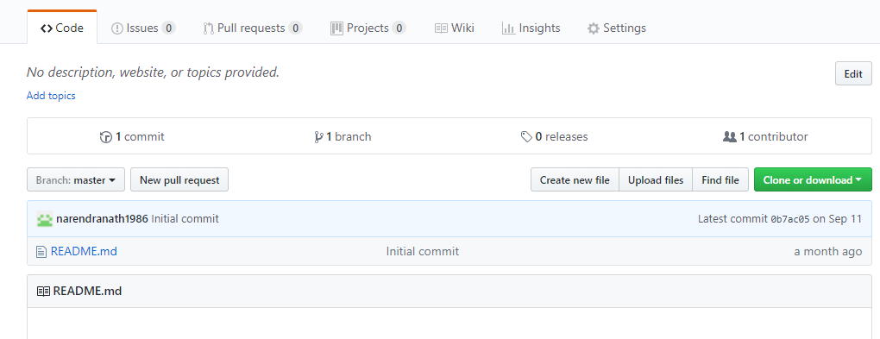
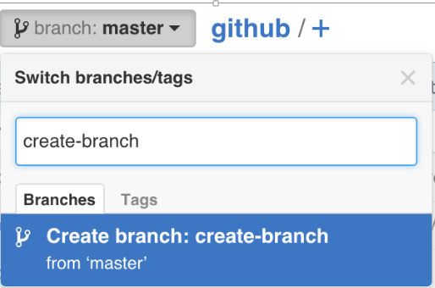
GitHub Repository (6)
Branching in GitHub
Branching enables to operate on various versions of a repository at the same time.
Master is the default branch of a repository.
A copy or snapshot of the master is captured when a branch is created from the master.
Changes made to the master by a different user, while working on the branch copy that can be pulled to the branch using the pull utility.
A new branch can be created by selecting the Branch menu in the repository.

Slide 11
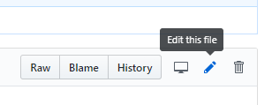
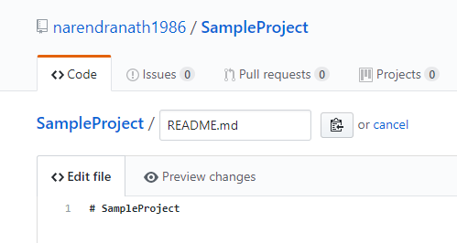
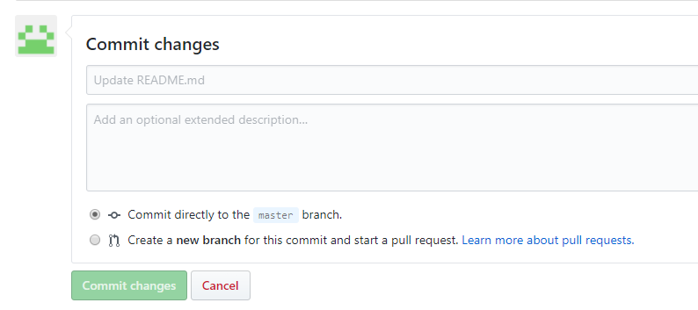
GitHub Repository (7)
Commit in GitHub
Following are the steps to edit and commit the changes in a file:
Click any file that had been created in the repository or click on the default README.md file which was created along with the repository.
Click the Edit this file icon.
Edit the file content in the Edit file tab.
Click Preview changes to view the changes. The new content will be displayed in Green.
Give a meaningful comment when committing which explains the changes made to the file.
One can choose to commit the changes to the current branch or to a new branch.
On master branch, choose to commit the changes in a new branch and then pull the changes through the pull request.
Click Commit changes to propose the file changes.

Slide 12
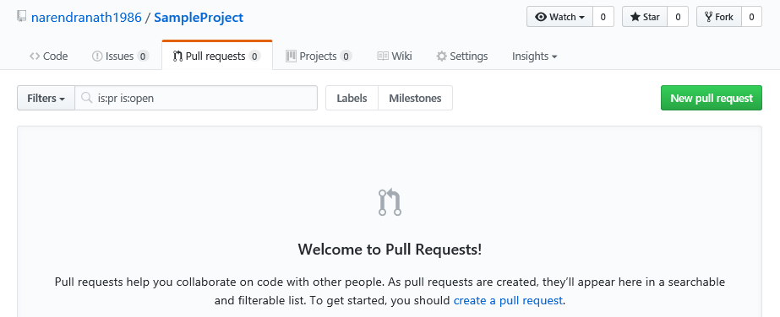
GitHub Repository (8)
Pull Requests
Pull requests identify the differences of the content in two branches.
All the differences and editions are highlighted in Green and Red.
Following are the steps to create Pull Requests:
Select the branch where the content was edited to compare with master (the original).
Click the Create Pull Request button.
When a pull request is created, the changes made are proposed, requesting user for review. The user can pull in the changes made and merge into the branch.
Click the Pull requests tab.
In the Pull Requests page, click the New Pull Request button.

Slide 13
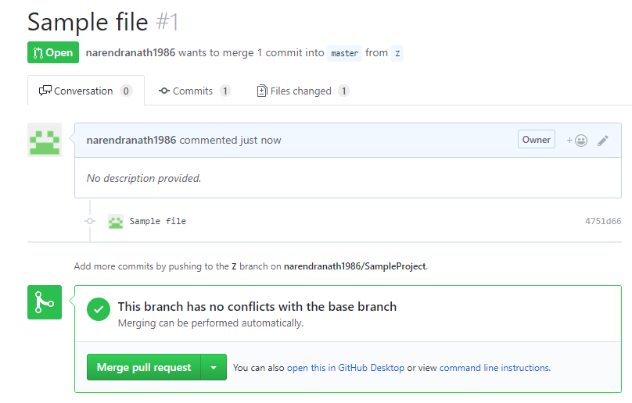
GitHub Repository (9)
Merge Changes through Pull Request
Following are the steps involved to merge the changes through pull requests:
1) To synchronize the branches, you can merge a branch into the master branch.
2) In order to merge changes into the master, click the green button for Merge pull request.
Example
The file 1 in the Z branch to be synchronized with the master branch.

Slide 14
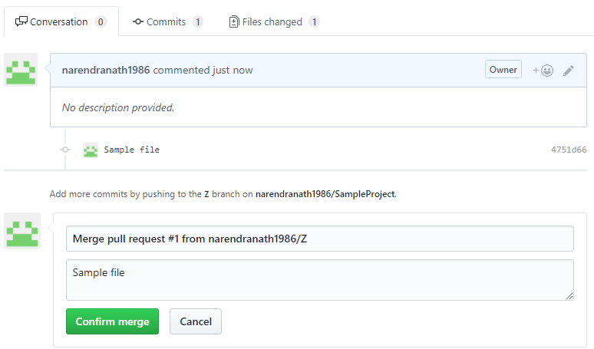
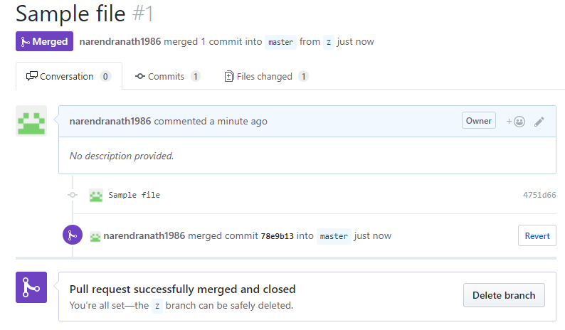
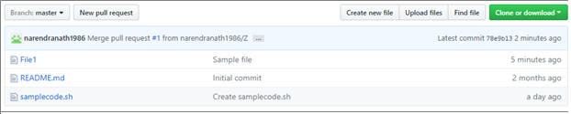
GitHub Repository (10)
Merge Changes through Pull Request
Following are the steps involved to merge the changes through pull requests:
3. Click Confirm merge.
Now, the branch Z can be deleted, as the changes have been incorporated into the master branch.
4. To delete, you can click the Delete branch button.
In the Master branch, after synchronization you can notice the file1.

Slide 15
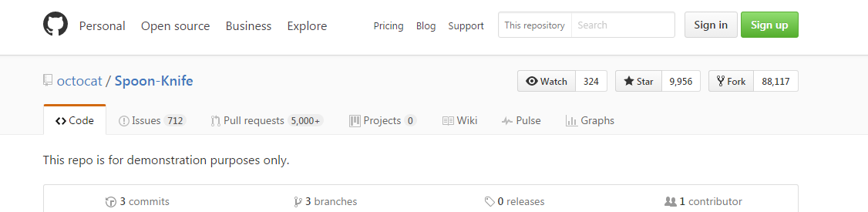
GitHub Repository (11)
Fork a Repository
On a project on GitHub, fork the repository, make the likeable changes, and release the revised project as a new repository.
The updates made to the original repository which was forked can easily be added to the current fork.
In GitHub, by accessing the following link the octocat Spoon-knife repository can be accessed: https://github.com/octocat/Spoon-Knife
Click Fork on the top right corner to fork a copy into the account as shown in the following screenshot:

Slide 16
Topic List
GitHub Repository
Git Bash Commands
Synchronizing Local and Remote Repository
Exercise 3.1: Working in GitHub
Exercise 3.2: Using Git Basic Commands

Slide 17

Git Bash Commands (1)
Introduction
Following are the examples of Git Bash commands:
Initialize a local repository
Clone - git clone <git-url>
Checkout – git checkout –b <new branch> (creates and switches to a new branch)
Add files - git add . (this adds all files in directory)
Commit - git commit -m “Added new search feature in script”
Tag - name & save different versions of code
Pull - git pull
Push - git push

Slide 18
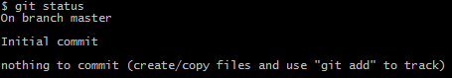
Git Bash Commands (2)
Initialize a Local Repository
To initialize the Repository, run the following command:
The following screen capture shows the result for initialized empty Git Repository:
Check the Status
Once the repository is initialized, try Git status command.
The following screen capture shows the Status command results:
$ git init
$ git status

Slide 19
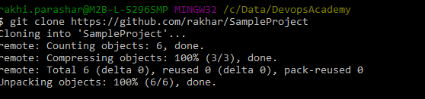
Git Bash Commands (3)
Clone the repository
Execute the following command in order to clone the repository into local machine which we created in github:
Following screen capture shows the result of using this command:
$ git clone https://github.com/rakhar/SampleProject or
$ git clone https://github.com/Accenture/adop-doa-materials.git

Slide 20
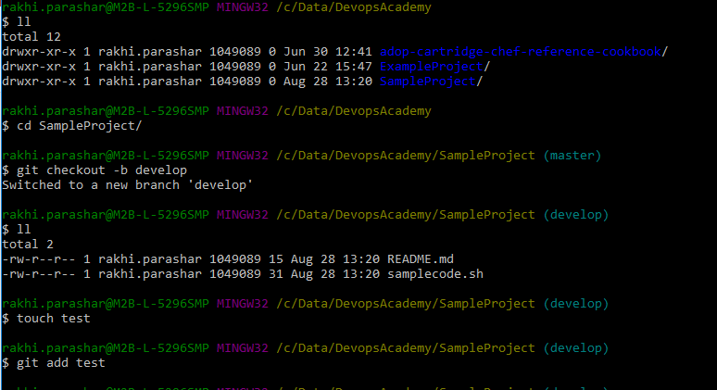
Git Bash Commands (4)
Adding File to a Repository
Create a text file in Git initialized folder and save the changes to the staging with the following command:
Following screen capture shows the result of using this command:
$ git add <filename>

Slide 21
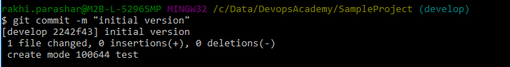
Git Bash Commands (5)
Commit the Changes to the Repository
To commit the changes to the Git repository, execute the following command:
Following screen capture shows the result of using this command:
$ git commit –m “comments”

Slide 22
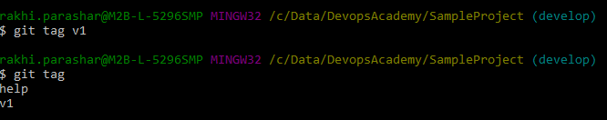
Git Bash Commands (6)
Tag a Repository
Following are the list of commands used to tag a repository:
Example
Commands | Usage
$git tag v1 | Assign a tag to the current version of the file.
$git checkout v1^ | Assign a tag to the previous version, instead of mentioning the hash while checking out.
$git tag v0 | Name the previous version as v0.
$git tag | View all the tags.
$git show v1 | View a particular tagged version of a file.

Slide 23
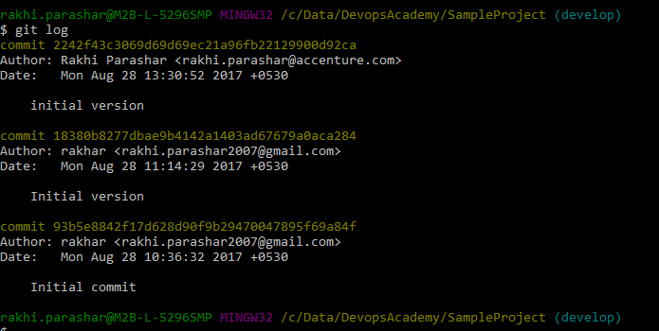
Git Bash Commands (7)
log Command
To log into the Git repository, execute the following command and see the result:
Following screen capture shows the result of using this command:
$ git log

Slide 24
Topic List
GitHub Repository
Git Bash Commands
Synchronizing Local and Remote Repository
Exercise 3.1: Working in GitHub
Exercise 3.2: Using Git Basic Commands

Slide 25
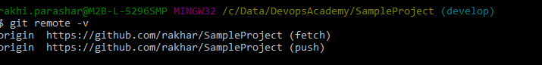
Synchronizing Local & Remote Repository (1)
Setting the Remote Repository
Following are the step to setup the remote repository:
Go to GITHUB and create an empty repository.
Set the remote repository in Git bash with the following command:
Add origin https://github.com/<githubuser>/<remotegitreponame> to the following command
This will set the remote repository
To change the mapping, the following command can be executed
The mentioned command will help to view the existing remotes.
$ git remote
$ git remote –v

Slide 26
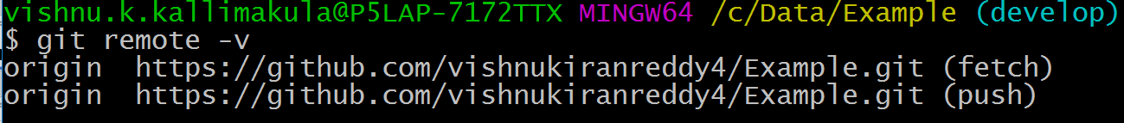
Synchronizing Local & Remote Repository (2)
Setting the Remote repository
The following command will help you to view the existing remotes :
$ git remote –v
Use the following command to rename an existing remote repository:
$ git remote rename origin destination
Note: Now the existing remote repository is renamed to destination. You can check by using the following command.
$ git remote –v

Slide 27
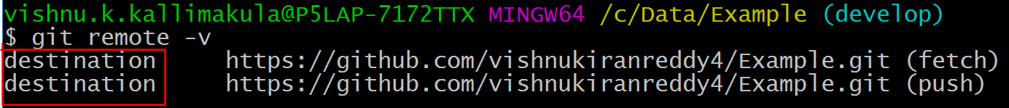
Synchronizing Local & Remote Repository (3)
Setting the Remote repository
Now, we can set a remote repository without cloning the repository.
Following are the steps to setup the remote repository:
Go to GitHub and create an empty repository.
Set the remote repository in Git bash with the following command:
$ git remote add origin https://github.com/vishnukiranreddy4/VishnuKiran.git

Slide 28
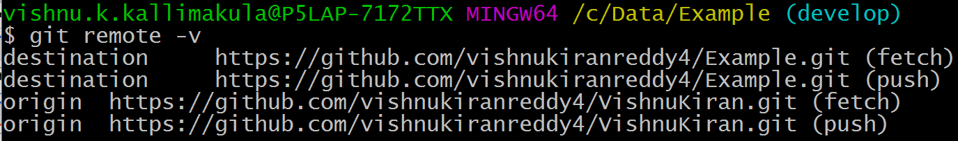
Synchronizing Local & Remote Repository (4)
Setting the Remote repository
Now you can see the existing remotes by using the following command:
$ git remote –v

Slide 29
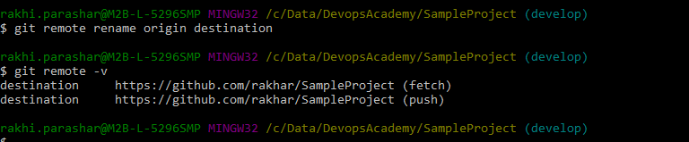
Synchronizing Local & Remote Repository (5)
Renaming the Remote Repository
Use the following command to rename an existing remote:
The two arguments of this command are:
An existing remote name. Example, origin.
A new name for the remote. Example, destination.
Following screen capture shows the result of using this command:
$ git remote rename origin destination

Slide 30
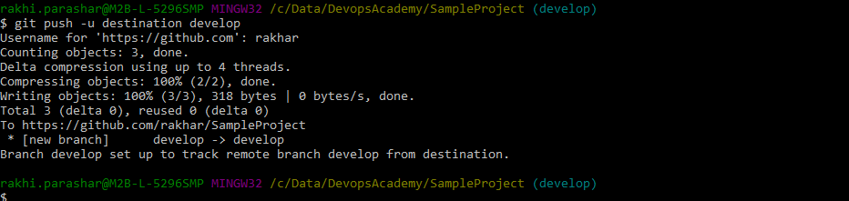
Synchronizing Local & Remote Repository (6)
push Command
Run the following command to push commit on the repository:
-u option: It makes Git to remember the parameter in order to execute just ‘GIT Push’. The next time Git will know where it needs to push.
Following screen capture shows the result of using this command:
$ git push –u origin master

Slide 31
Synchronizing Local & Remote Repository (7)
pull Command
To pull the changes to local repository, run the following command.
Note: If there are changes updated to the remote repository (could be by a different user ), the changes can be pulled into/updated to the local repository using the Git Pull command.
$ git pull <repository>

Slide 32
Topic List
GitHub Repository
Git Bash Commands
Synchronizing Local and Remote Repository
Exercise 3.1: Working in GitHub
Exercise 3.2: Using Git Basic Commands

Slide 33
Exercise 3.1: Working in GitHub
Scenario
Create an account in Github and create a smaple project where you need to:
Create a GitHub Account
Create repository
Preview the created repository
Add files to the project
View the new files add or edit comments

Slide 34
Topic List
GitHub Repository
Git Bash Commands
Synchronizing Local and Remote Repository
Exercise 3.1: Working in GitHub
Exercise 3.2: Using Git Basic Commands

Slide 35
Exercise 3.2: Using Git Basic Commands
Scenario
Perform following tasks using the basic Git commands:
Cloning the repository created in GitHub into local machine
Adding file to a repository
Committing the changes to the Repository
Using GIT Push Command
Tagging a repository
Viewing the log details of the repository
Synchronizing the local & remote repository
Using pull command to update the changes to the remote repository

Slide 36

Knowledge Check
Select the right answer
In which of the following, Master is the default branch of a repository?
Commit in GITHub
Pull Requests
Branching in Git Hub
Fork a Repository

Slide 37
Knowledge Check
Select the right answer
Which is not an example of Git Bash commands?
Clone
Commit
Tag
Branch

Slide 38
Describe Git Hub Repository.
Describe techniques like Branching, Commiting, Pull Requests, and Merging with respect to GITHub Repository.
Apply various Git Bash commands.
Use the commands to synchronize the local and remote repository.

Slide 39
Thank You

